Slide 1
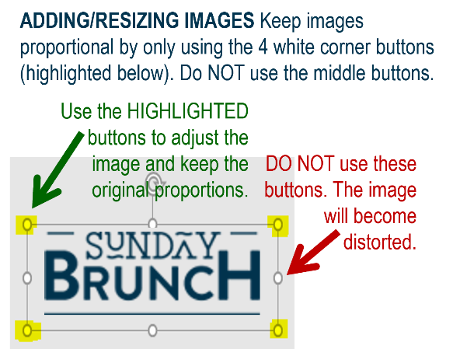















MFB Kitchen & Cafe
July 2025
 | 7/28 Monday | 7/29 Tuesday | 7/30 Wednesday | 7/31 Thursday | 8/1 Friday
Breakfast & Carve | BYO Breakfast Bowl Chipotle Chicken Thighs | Biscuits and Gravy Pot Roast with Mashed Potatoes and Carrots | Waffle Wednesday Herb Roasted Pork Loin with Roasted Potatoes | Biscuits and Gravy Chicken Teriyaki w/ Stir-fry Veggies | BYO Omlette Fish and Chips w/slaw
Soup | White Chicken Chili | Cheeseburger Chowder | Chicken Tortilla | Tomato Basil | Broccoli Cheese
Market Deli & The Oven | California Reuben Chicken and Broccoli Tortellini Alfredo | Chicken Salad Wrap Spaghetti w/Meat Sauce | Veggie Wrap Bacon Mac and Cheese | BYO Sandwiches Vegetarian Pasta Primavera | Pepperoni Pizza Chef’s Choice Lasagna
Chef’s Table |  | Nacho Bar | Ramen Bowls | BYO Mac and Cheese
Open 7 days a week
Breakfast 7 am – 9:30 am
Lunch 11 am – 2 pm
Dinner 2 pm-7 pm
Weekends 7 am- 2pm

