Slide 1
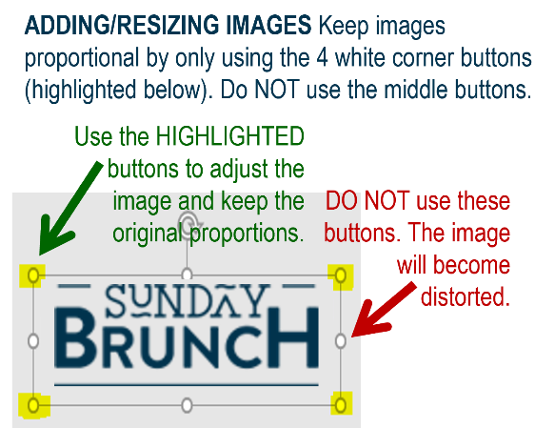















MFB Kitchen & Cafe
July 2025
 | 6/30 Monday | 7/1 Tuesday | 7/2 Wednesday | 7/3 Thursday | 7/4 Friday
Breakfast & Carve | BYO Breakfast Bowl Chipotle Chicken Thighs | Biscuits and Gravy Pot Roast with Mashed Potatoes and Carrots | Waffle Wednesday Herb Roasted Pork Loin with Roasted Potatoes | Biscuits and Gravy Chicken Teriyaki w/ Stir-fry Veggies
Soup | White Chicken Chili | Cheeseburger Chowder | Chicken Tortilla | Tomato Basil | Happy Independence Dat!
Market Deli & The Oven | California Reuben Chicken and Broccoli Tortellini Alfredo | Chicken Salad Wrap Spaghetti w/Meat Sauce | Veggie Wrap Bacon Mac and Cheese | BYO Sandwiches Vegetarian Pasta Primavera | Café Closed
Chef’s Table |  | Nacho Bar | Chicken Wings | Loaded Baked Potatoes
Open 7 days a week
Breakfast 7 am – 9:30 am
Lunch 11 am – 2 pm
Dinner 2 pm-7 pm
Weekends 7 am- 2pm

