Slide 1
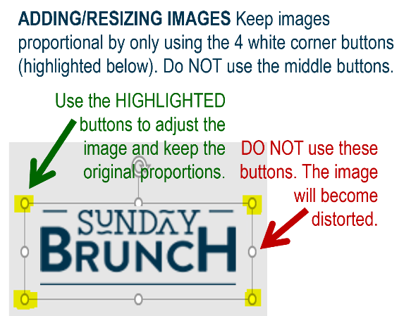
MFB Kitchen & Cafe
July 2025
 | 7/7 Monday | 7/8 Tuesday | 7/9 Wednesday | 7/10 Thursday | 7/11 Friday
Breakfast & Carve | BYO Breakfast Bowl Meatloaf and Mashed Potatoes | Biscuits and Gravy BBQ Chicken w/ Mac and Cheese | Waffle Wednesday Beef Tips in Mushroom Gravy | Biscuits and Gravy Sweet Chili Chicken | BYO Omlette Chef’s Choice Salmon
Soup | White Chicken Chili | Cheeseburger Chowder | Chicken Tortilla | Tomato Basil | Broccoli Cheese
Market Deli & The Oven | Chicken Cordon Bleu Tortellini w/Pesto Sauce | Italian Sandwich Cheesesteak Pasta | BYO Sandwich Stuffed Shells Florentine | 3 Pigs Pizza Penne w/Vodka Sauce | Supreme Pizza Chef’s Choice Lasagna
Chef’s Table |  | Burritos/Bowls | Polish Plates | Gyros
Open 7 days a week
Breakfast 7 am – 9:30 am
Lunch 11 am – 2 pm
Dinner 2 pm-7 pm
Weekends 7 am- 2pm

