Slide 1
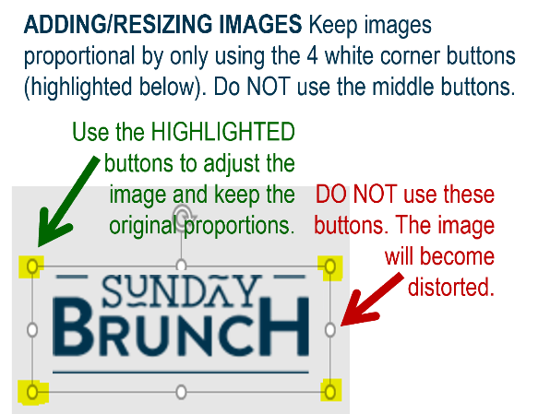
MFB Kitchen & Cafe
July 2025
 | 7/21 Monday | 7/22 Tuesday | 7/23 Wednesday | 7/24 Thursday | 7/25 Friday
Breakfast & Carve | BYO Breakfast Bowl Fried Chicken | Biscuits and Gravy Chicken and Sausage Gumbo over Rice | Waffles Hand-Carved Beef Brisket | Biscuits and Gravy Orange Chicken w/Stir-Fry Veggies | BYO Omlette Crab Cakes
Soup | White Chicken Chili | Cheeseburger Chowder | Chicken Tortilla | Tomato Basil | Broccoli Cheese
Market Deli & The Oven | Ham and Swiss on Pretzel Bun Tortellini in Pesto Sauce | Buffalo Chicken Salad Cheesesteak Pasta | Veggie Warp Stuffed Shells Florentine | BYO Sandwich Penne w/Vodka Sauce | 4 Cheese Pizza Chef’s Choice Lasagna
Chef’s Table |  | Taco Bar | BYO Hot Dogs | Limited Time Offer: Italian Chopped Salad
Open 7 days a week
Breakfast 7 am – 9:30 am
Lunch 11 am – 2 pm
Feast 2 pm- 7 pm
Weekends 7 am- 2pm

