Slide 1
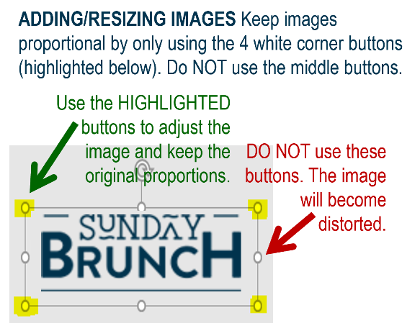















MFB Kitchen & Cafe
September 2024
Hispanic Heritage Month! | 9/23 Monday | 9/24 Tuesday | 9/25 Wednesday | 9/26 Thursday | 9/27 Friday
Breakfast & Carve | B.Y.O. Omlette Grilled BBQ Chicken | Biscuits and Gravy Turkey Sloppy Joes | Waffles Chicken and Sausage Gumbo | Breakfast Bowls Beef Tips and Noodles | BYO Omlette Shrimp Scampi
Soup | White Chicken Chili | Fruit Bar- with Tajin! Cabbage Soup | Split Pea with Ham | Elote Thursday Tomato Basil Bisque | Broccoli Cheese
Market Deli & The Oven | California Reuben Ham and Pepperoni Pizza | Chicken Salad Wrap Baked Ziti with Meat Sauce | Mediterranean Veggie Wrap Cajun Chicken Alfredo | 4 Cheese Pizza Baked Spaghetti | Pepperoni Pizza Lasagna
Chef’s Table |  | Tortas | Chicken Pozole | Asian Noodle Bowls
Dinner | Buffalo Chicken Mac and Cheese | Turkey Goulash | Gumbo with Rice | Beef Stroganoff | Pizza
Open 7 days a week
Breakfast 7 am – 9:30 am
Lunch 11 am – 2 pm
Feast 2 pm- 7 pm
Weekends 7 am- 2pm

