Slide 1
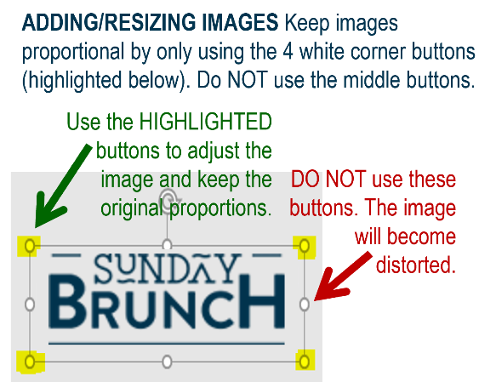














MFB Kitchen & Cafe
Sept. 2025
 | 9/1 Monday | 9/2 Tuesday | 9/3 Wednesday | 9/4 Thursday | 9/5 Friday
Breakfast & Carve | Happy | Biscuits and Gravy BBQ Chicken w/ Sweet Potato Mash | Waffle Wednesday Sweet Chili Chicken Lo Mein | Biscuits and Gravy Beef Stroganoff | BYO Omlette Chicken Parmesan
Soup | Labor Day! | Cheeseburger Chowder | Chicken Tortilla | Tomato Basil | Broccoli Cheese
Market Deli & The Oven | Café Closed | Italian Sandwich Five Cheese Baked Ziti | BYO Sandwich Stuffed Shells Florentine | 3 Pigs Pizza Penne w/Vodka Sauce | Supreme Pizza Chef’s Choice Lasagna
Chef’s Table |  | Flautas | Hot Dogs | BYO Salad
Open 7 days a week
Breakfast 7 am – 9:30 am
Lunch 11 am – 2 pm
Dinner 2 pm-7 pm
Weekends 7 am- 2pm

