Slide 1
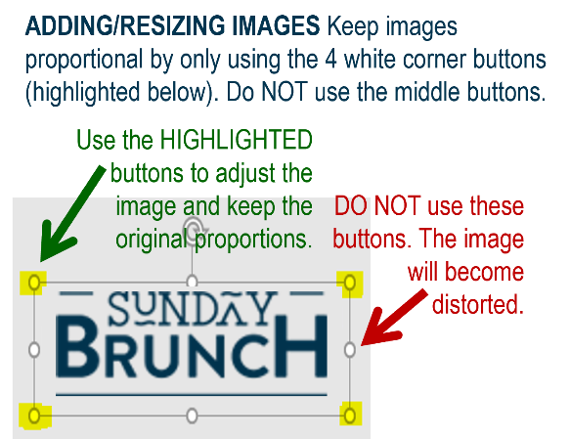















MFB Kitchen & Cafe
Sept. 2025
 | 9/8 Monday | 9/9 Tuesday | 9/10 Wednesday | 9/11 Thursday | 9/12 Friday
Breakfast & Carve | B.Y.O. Omlette Bruschetta Chicken w/Wild Rice | Biscuits and Gravy Sweet Chili Meatballs w/Fried Rice | Waffles Beef and Broccoli | Biscuits and Gravy “MFB” Bowls | BYO Omlette Pot Roast with Mashed Potatoes
Soup | White Chicken Chili | Cheeseburger Chowder | Chicken Tortilla | Tomato Basil | Broccoli Cheese
Market Deli & The Oven | Corned Beef Reuben Spaghetti w/Meat Sauce | Chicken, Bacon and Ranch Wrap Penne with Italian Sausage in Tomato Cream Sauce | BYO Sandwich Chicken, Bacon and Ranch Cavatappi | Corned Beef Reubens Pasta Primavera | Pepperoni Pizza Chef’s Choice Lasagna
Chef’s Table |  | Tostadas | BYO Grilled Cheese | BYO Gyros
Open 7 days a week
Breakfast 7 am – 9:30 am
Lunch 11 am – 2 pm
Feast 2 pm- 7 pm
Weekends 7 am- 2pm

