Slide 1
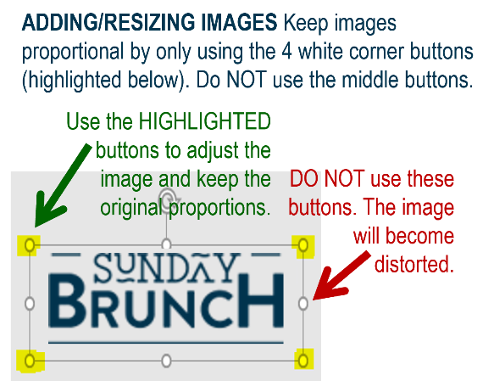














MFB Kitchen & Cafe
September 2025
 | 9/15 Monday | 9/16 Tuesday | 917 Wednesday | 9/18 Thursday | 9/19 Friday
Breakfast & Carve | BYO Breakfast Bowl Fried Chicken and Baked Beans | Biscuits and Gravy Pork Chops with Grilled Peach Salsa | Rehab Week | Biscuits and Gravy Orange Chicken w/Stir-Fry Veggies | BYO Omlette Crab Cakes with Roasted Corn Salad
Soup | White Chicken Chili | Cheeseburger Chowder | Cook-out! | Tomato Basil | Broccoli Cheese
Market Deli & The Oven | EVS Week Special: “The Clean Dream” Sandwich Mushroom and Pesto Gnocchi | EVS Week Special: “The Clean Dream” Sandwich Five Cheese Baked Ziti | 11:00am-2:00pm | BYO Sandwich Penne w/Vodka Sauce | Ham and Swiss on Pretzel Chef’s Choice Lasagna
Chef’s Table |  | BYO Nachos | POB Parking Lot | Wings
Open 7 days a week
Breakfast 7 am – 9:30 am
Lunch 11 am – 2 pm
Feast 2 pm- 7 pm
Weekends 7 am- 2pm

