Slide 1
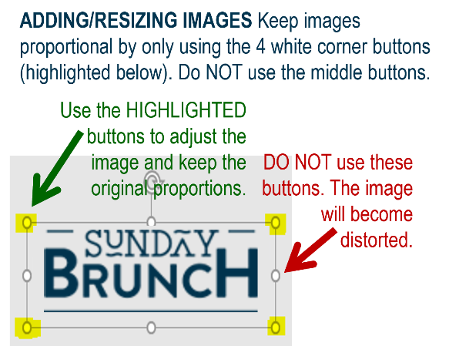














MFB Kitchen & Cafe
Sept. 2025
 | 9/29 Monday | 9/30 Tuesday | 10/1 Wednesday | 10/2 Thursday | 10/3 Friday
Breakfast & Carve | BYO Omlette Salisbury Steak with Mashed Potatoes | Biscuits and Gravy BBQ Chicken w/ Sweet Potato Mash | Waffle Wednesday Sweet Chili Chicken Lo Mein | Biscuits and Gravy Beef Stroganoff | BYO Omlette Chicken Parmesan
Soup | White Chicken Chili | Cheeseburger Chowder | Chicken Tortilla | Tomato Basil | Broccoli Cheese
Market Deli & The Oven | California Reuben Mushroom and Pesto Gnocchi | Italian Sandwich Five Cheese Baked Ziti | BYO Sandwich Stuffed Shells Florentine | 3 Pigs Pizza Penne w/Vodka Sauce | Supreme Pizza Chef’s Choice Lasagna
Chef’s Table |  | Tacos | Hot Dogs | BYO Salad
Open 7 days a week
Breakfast 7 am – 9:30 am
Lunch 11 am – 2 pm
Dinner 2 pm-7 pm
Weekends 7 am- 2pm

