Slide 1
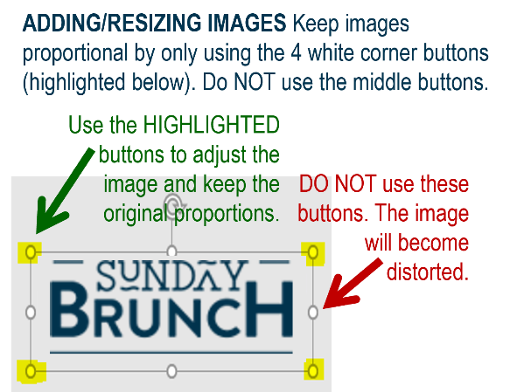














MFB Kitchen & Cafe
December 2025
 | 12/8 Monday | 12/9 Tuesday | 12/10 Wednesday | 12/11 Thursday | 12/12 Friday
Breakfast & Carve | BYO Breakfast Bowl Sweet Chili Meatballs | Biscuits and Gravy Traditional Gumbo | Waffles Hand-Carved Beef Brisket | Biscuits and Gravy Orange Chicken w/Stir-Fry Veggies | BYO Omlette Crab Cakes with Roasted Corn Salad
Soup | Chicken and Wild Rice | Three Bean Chili | Loaded Baked Potato | Butternut Squash Bisque | Broccoli Cheese
Market Deli & The Oven | Ham and Swiss on Pretzel Bun Cajun Chicken Sausage Penne | Buffalo Chicken Salad 5 Cheese Baked Ziti | BYO Sandwich Stuffed Shells Florentine | BYO Sandwich Penne w/Vodka Sauce | 4 Cheese Pizza Chef’s Choice Lasagna
Chef’s Table |  | Burritos/Bowls | BYO Mac and Cheese | Risotto Bowls
Open 7 days a week
Breakfast 7 am – 9:30 am
Lunch 11 am – 2 pm
Feast 2 pm- 7 pm
Weekends 7 am- 2pm

