Slide 1
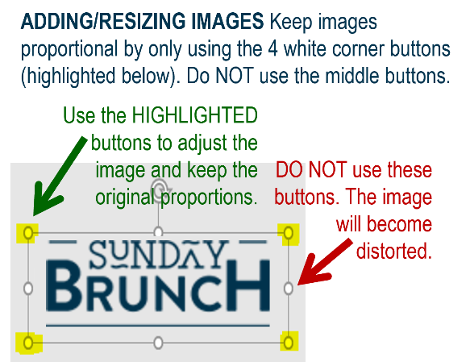















MFB Kitchen & Cafe
December 2025
 | 12/1 Monday | 12/2 Tuesday | 12/3 Wednesday | 12/4 Thursday | 12/5 Friday
Breakfast & Carve | B.Y.O. Omlette Beef Barbacoa | Biscuits and Gravy Cajun Smothered Chicken | Waffles MFB “Famous” Bowls | Biscuits and Gravy Caprese Chicken | BYO Omlette Pot Roast with Mashed Potatoes and Braised Carrots
Soup | Chicken and Wild Rice | Three Bean Chili | Loaded Baked Potato | Butternut Squash Bisque | Broccoli Cheese
Market Deli & The Oven | Corned Beef Reuben Penne w/Meat Sauce | Chicken, Bacon and Ranch Wrap Penne with Italian Sausage in Tomato Cream Sauce | BYO Sandwich Chicken, Bacon and Ranch Farfalle | Corned Beef Reubens Butternut, Spinach and Walnut Spaghetti | Pepperoni Pizza Chef’s Choice Lasagna
Chef’s Table |  | Tacos | BYO Chili Bowls | Loaded Baked Potatos
Open 7 days a week
Breakfast 7 am – 9:30 am
Lunch 11 am – 2 pm
Feast 2 pm- 7 pm
Weekends 7 am- 2pm

