Slide 1
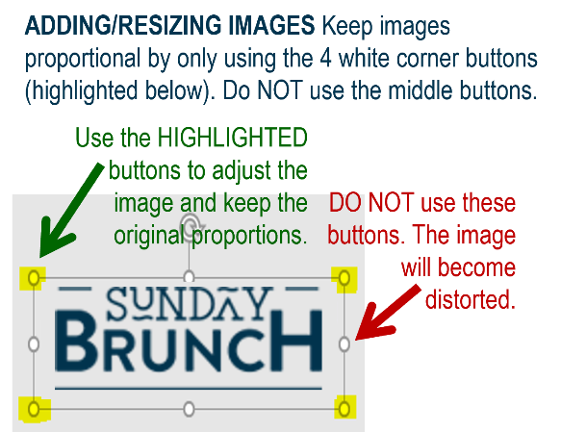















MFB Kitchen & Cafe
December 2025
 | 12/15 Monday | 12/16 Tuesday | 12/17 Wednesday | 12/18 Thursday | 12/19 Friday
Breakfast & Carve | BYO Breakfast Bowl Chipotle Chicken Thighs | Biscuits and Gravy Braised Beef and Sweet Potato Hash | Waffle Wednesday Herb Roasted Pork Loin with Roasted Potatoes | Biscuits and Gravy Chicken Teriyaki w/ Stir-fry Veggies | BYO Omlette Fish and Chips
Soup | Chicken and Wild Rice | Three Bean Chili | Loaded Baked Potato | Butternut Squash Bisque | Broccoli Cheese
Market Deli & The Oven | California Reuben Penne with Meat Sauce | Chicken Salad Wrap Italian Sausage Penne in Tomato Cream Sauce | Veggie Wrap Chicken, Bacon and Ranch Farfalle | BYO Sandwiches Butternut, Spinach and Walnut Spaghetti | Pepperoni Pizza Chef’s Choice Lasagna
Chef’s Table |  | Fajitas | BYO Pasta | Loaded French Fry Bar
Open 7 days a week
Breakfast 7 am – 9:30 am
Lunch 11 am – 2 pm
Dinner 2 pm-7 pm
Weekends 7 am- 2pm

