Slide 1
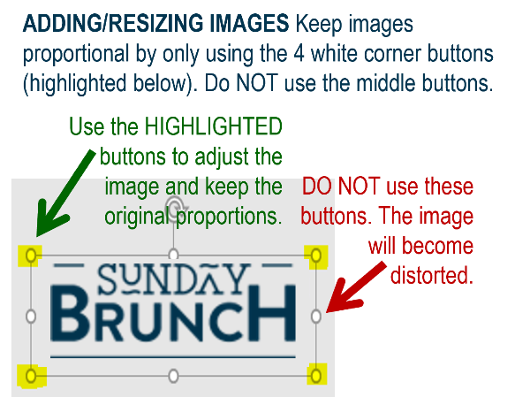














MFB Kitchen & Cafe
December 2025
 | 12/22 Monday | 12/23 Tuesday | 12/24 Wednesday | 12/25 Thursday | 12/26 Friday
Breakfast & Carve | BYO Breakfast Bowl Meatloaf and Mashed Potatoes | Biscuits and Gravy Beef and Broccoli | Waffle Wednesday BBQ Chicken with Mac and Cheese | Merry Christmas! | BYO Omlette Chicken Pot Pie
Soup | White Chicken Chili | Cheeseburger Chowder | Chicken Tortilla | Café Grills will be open 7:00am-2:00pm | Broccoli Cheese
Market Deli & The Oven | Chicken Cordon Bleu Sandwich Cajun Chicken Sausage Penne | Italian Sandwich Five Cheese Baked Ziti | BYO Sandwich Stuffed Shells Florentine | Christmas Meal Available 11:00am-2:00pm | Supreme Pizza Chef’s Choice Lasagna
Chef’s Table |  | Tacos | Gyros | In MFB Cafe
Open 7 days a week
Breakfast 7 am – 9:30 am
Lunch 11 am – 2 pm
Dinner 2 pm-7 pm
Weekends 7 am- 2pm

